Slide 1


Slide 2
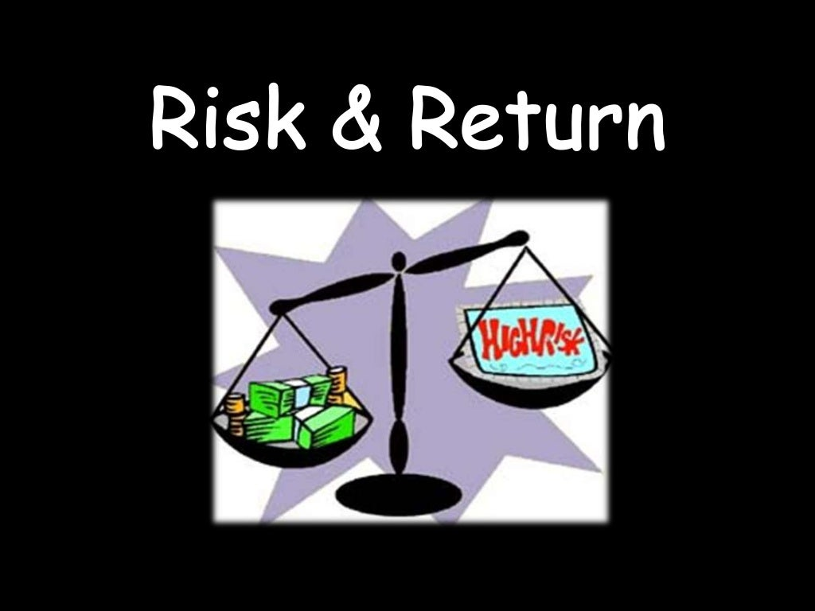

Slide 3


Slide 4
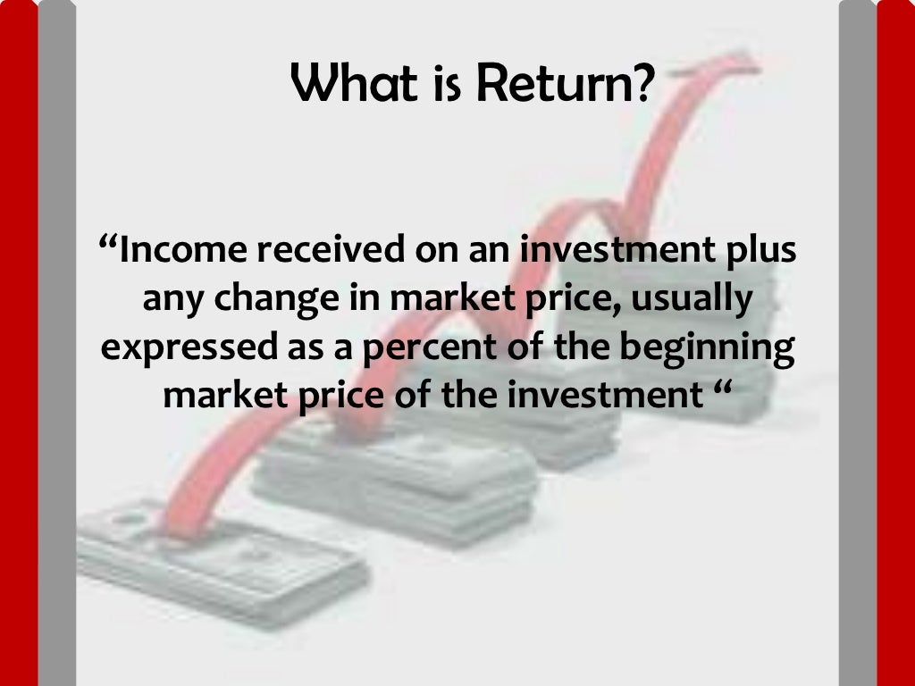

Slide 5
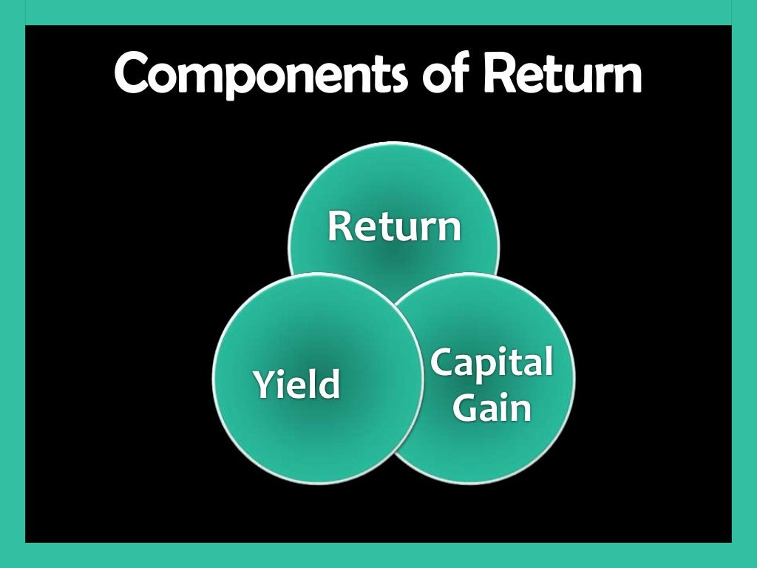

Slide 6
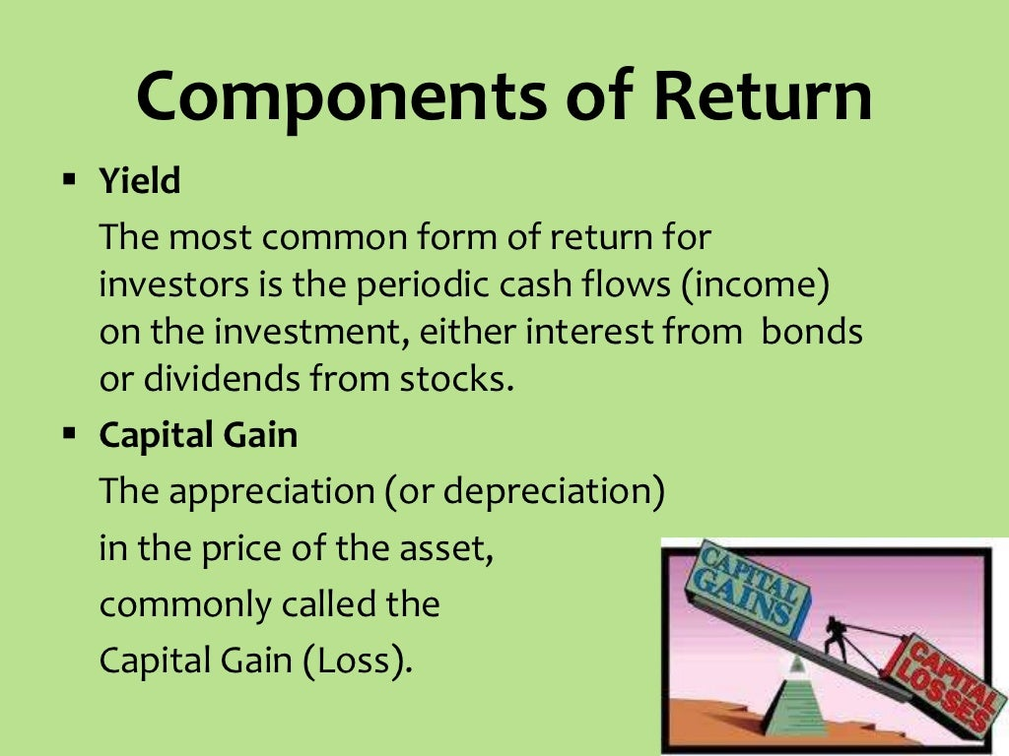

Slide 7
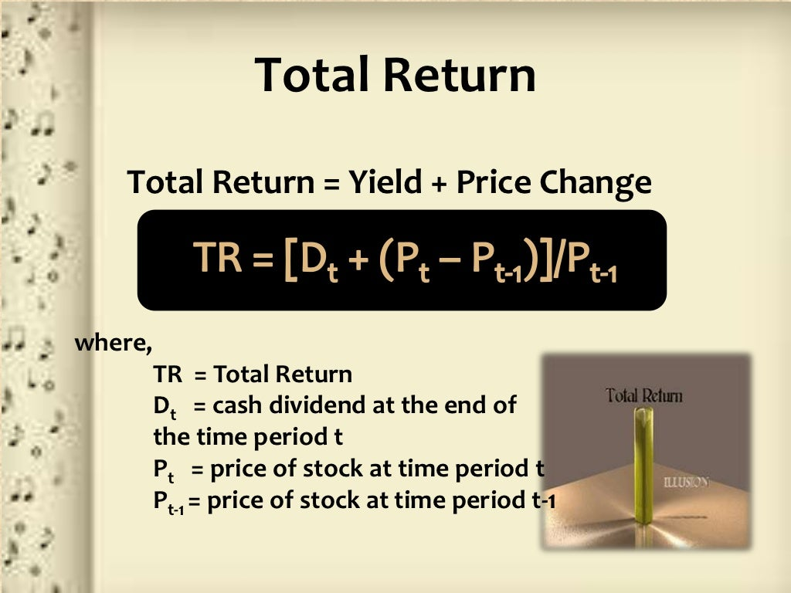

Slide 8
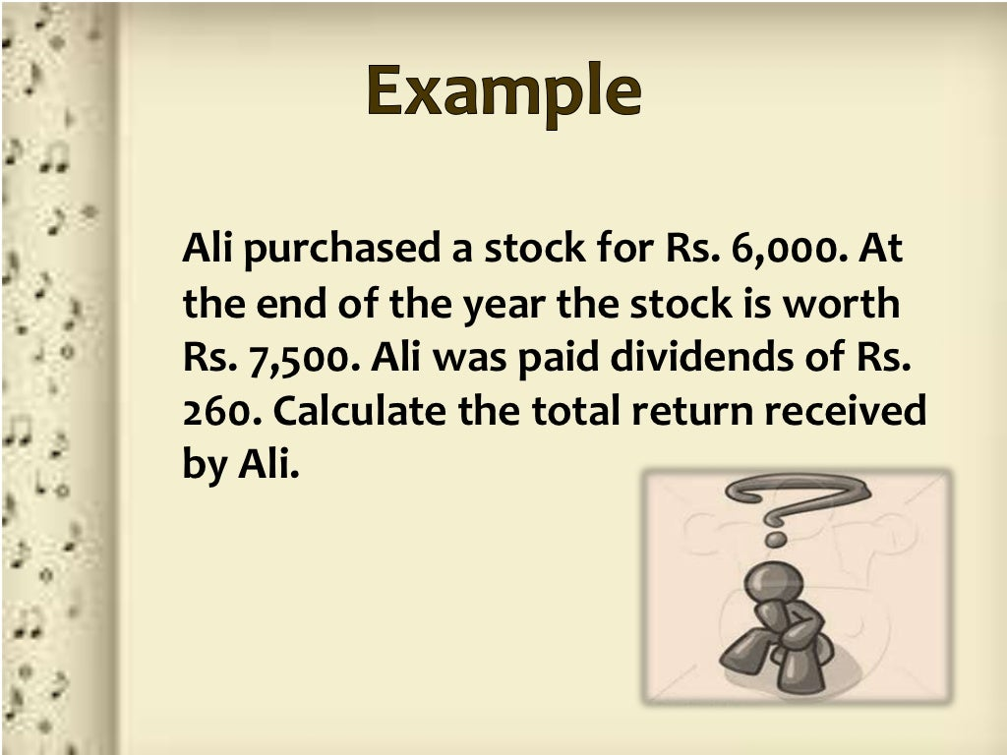

Slide 9
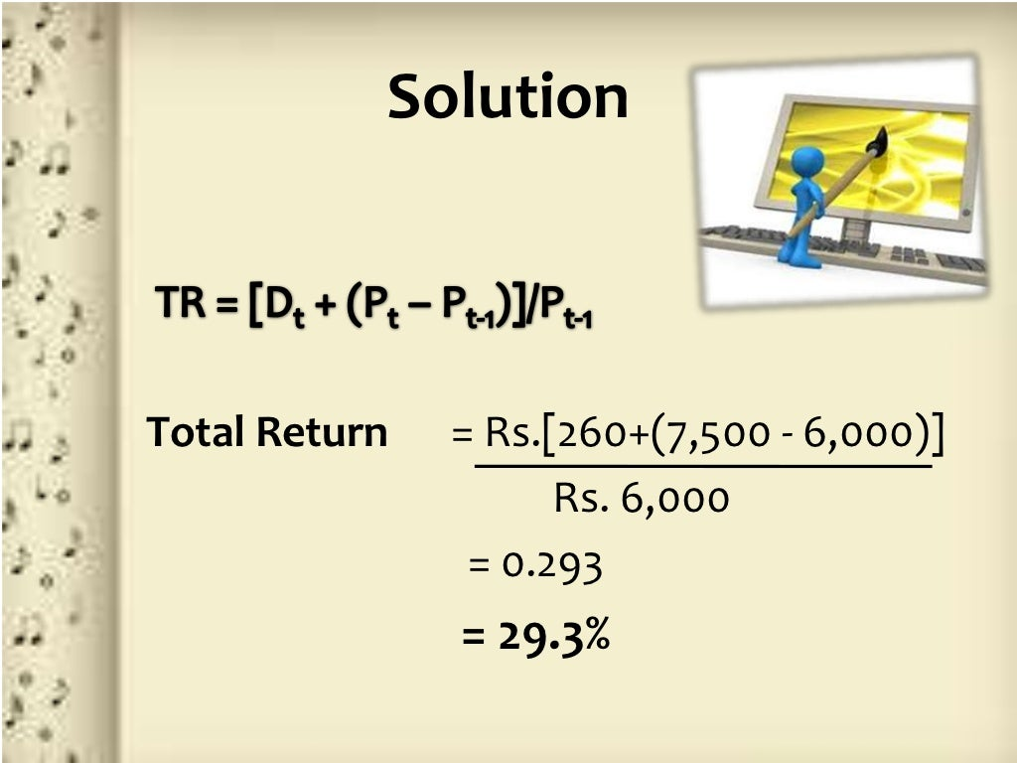

Slide 10
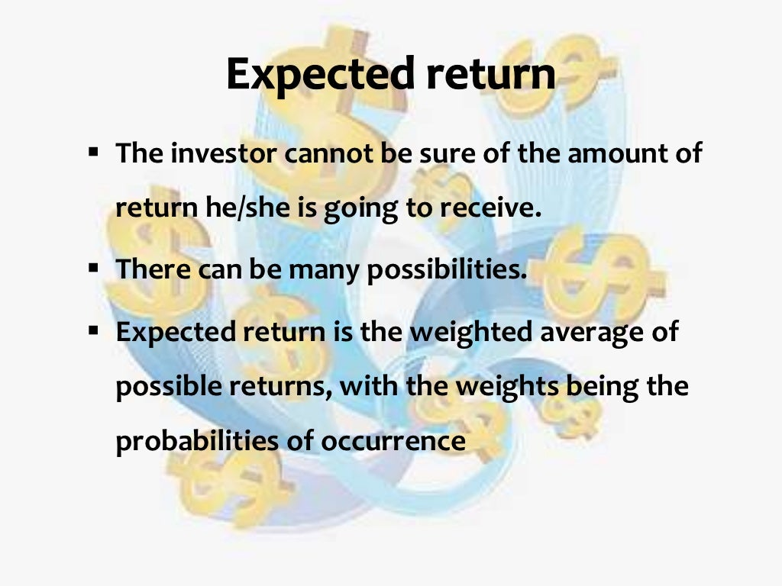

Slide 11
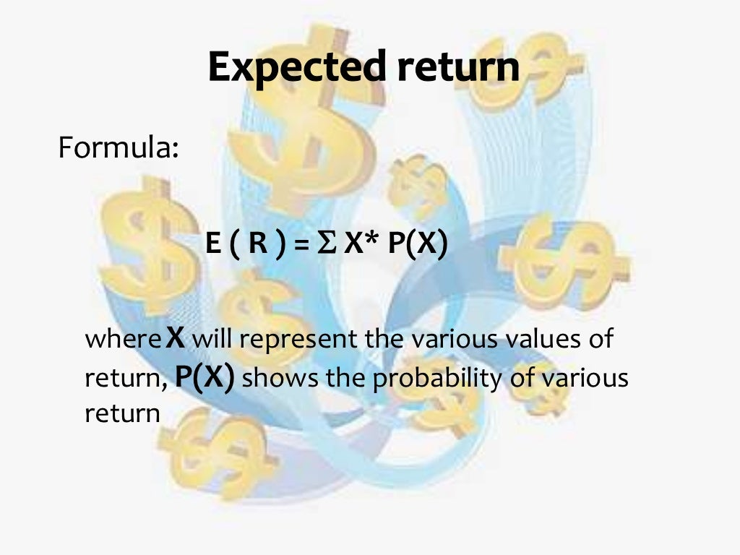

Slide 12
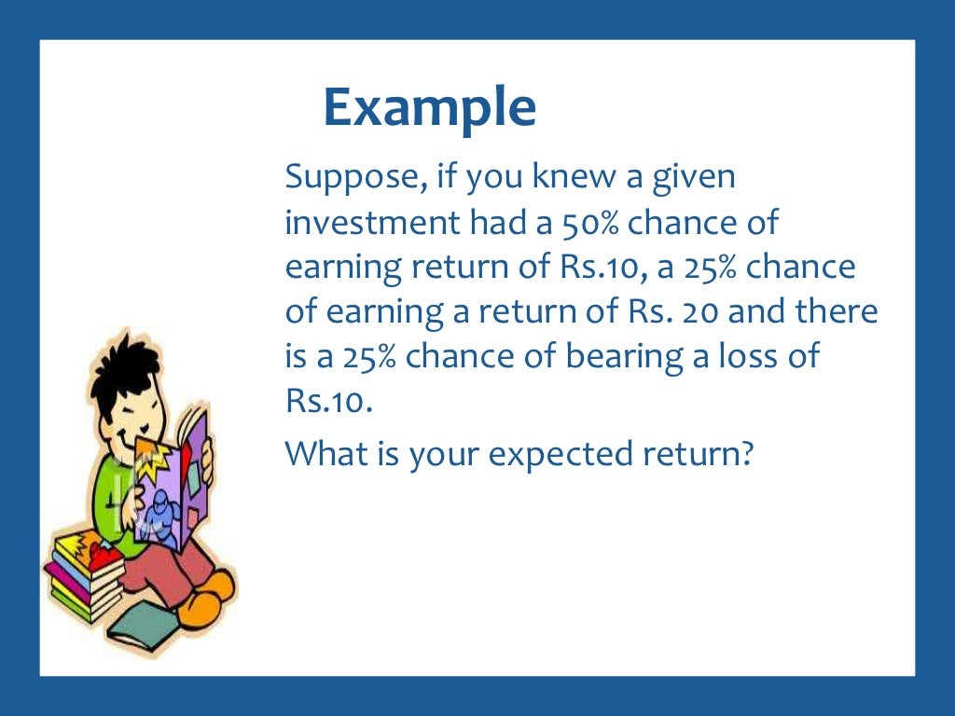

Slide 13
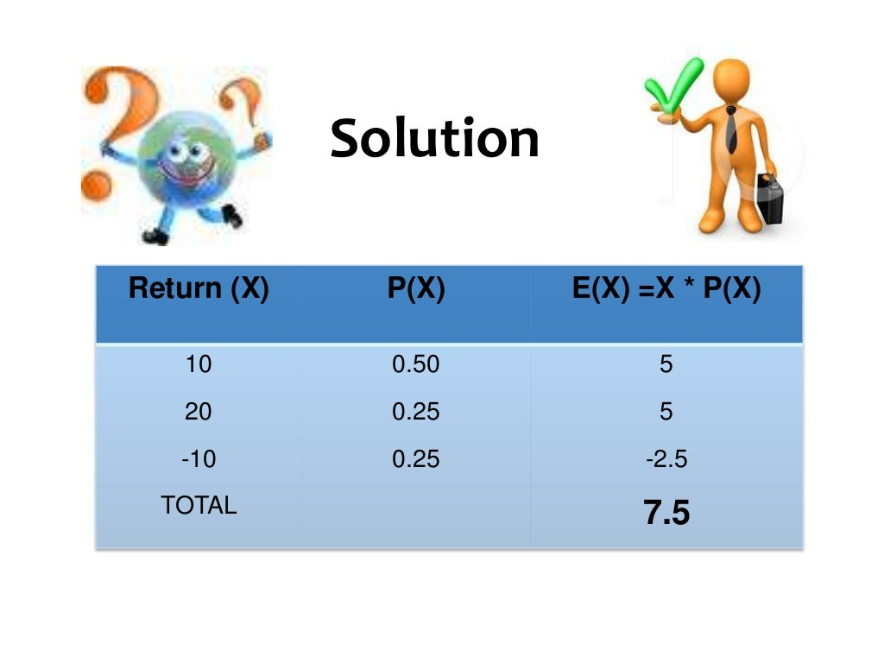

Slide 14
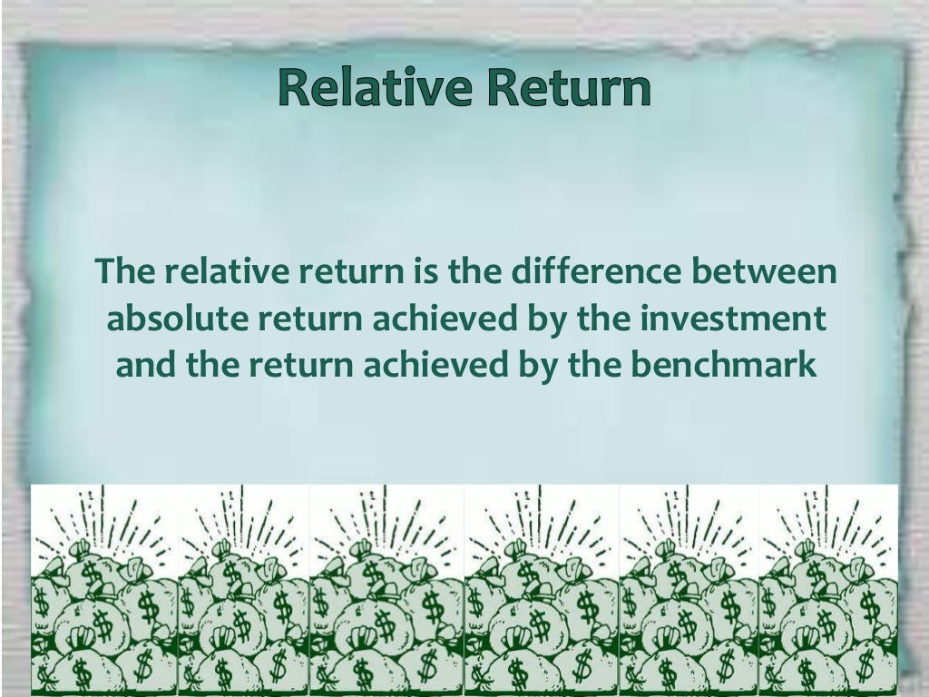

Slide 15
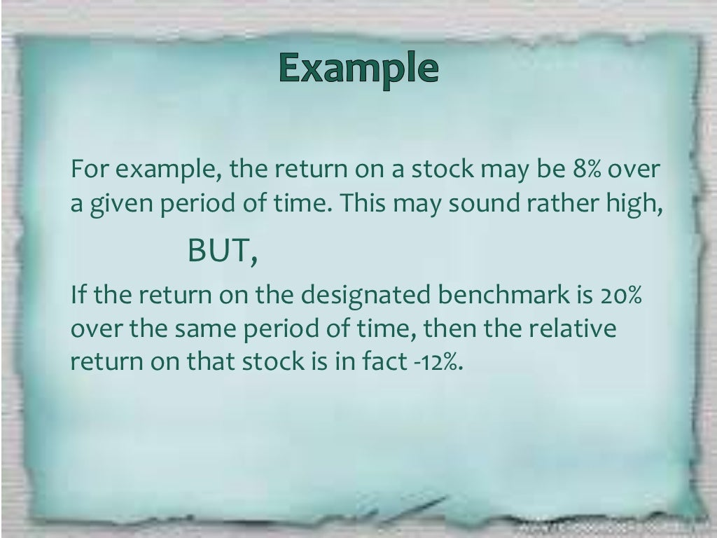

Slide 16
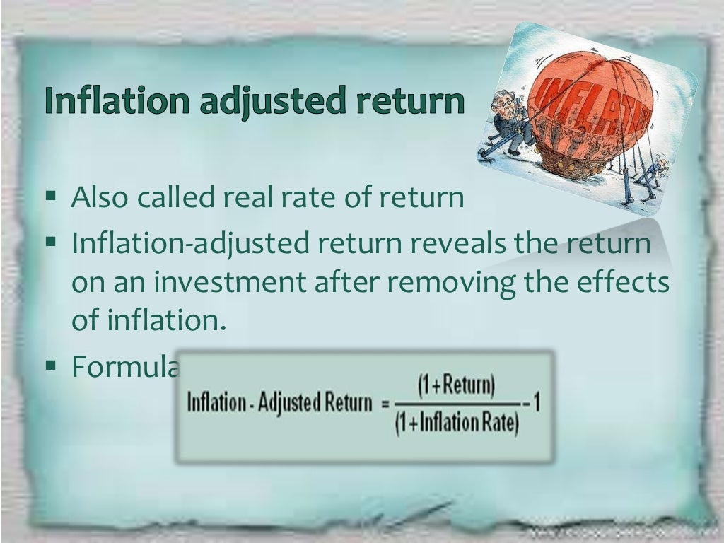

Slide 17
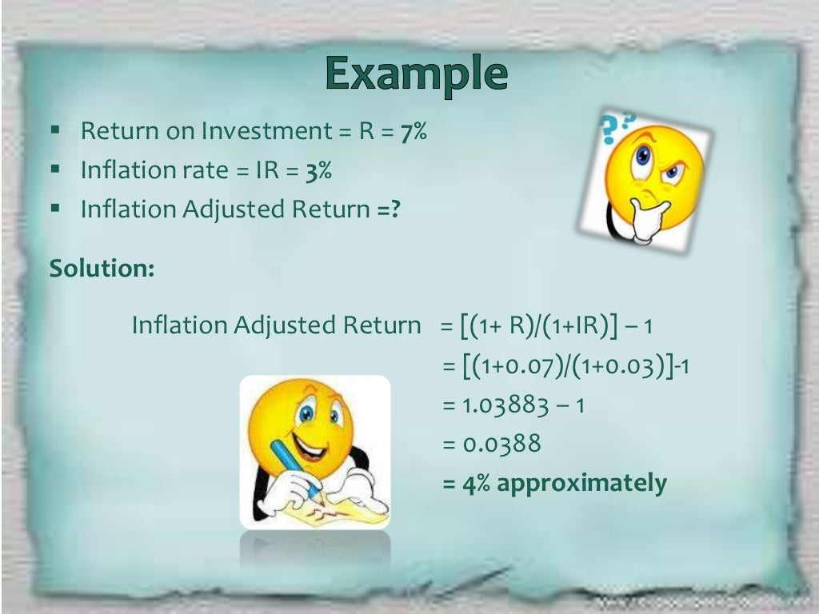

Slide 18
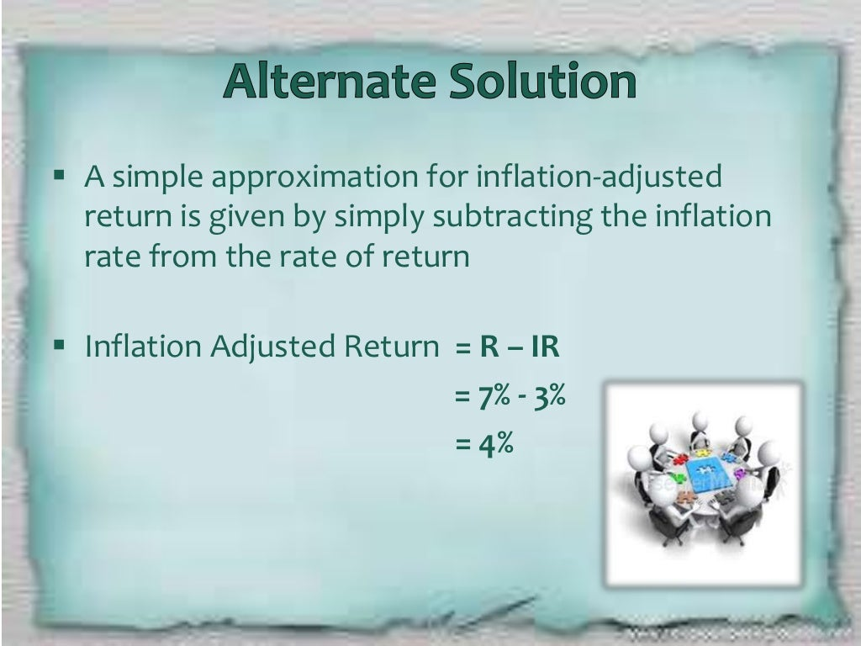

Slide 19
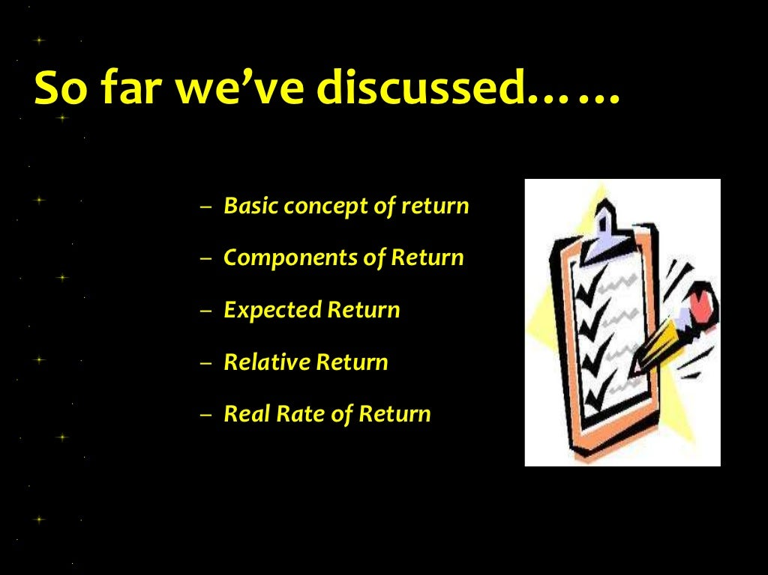

Slide 20


Slide 21
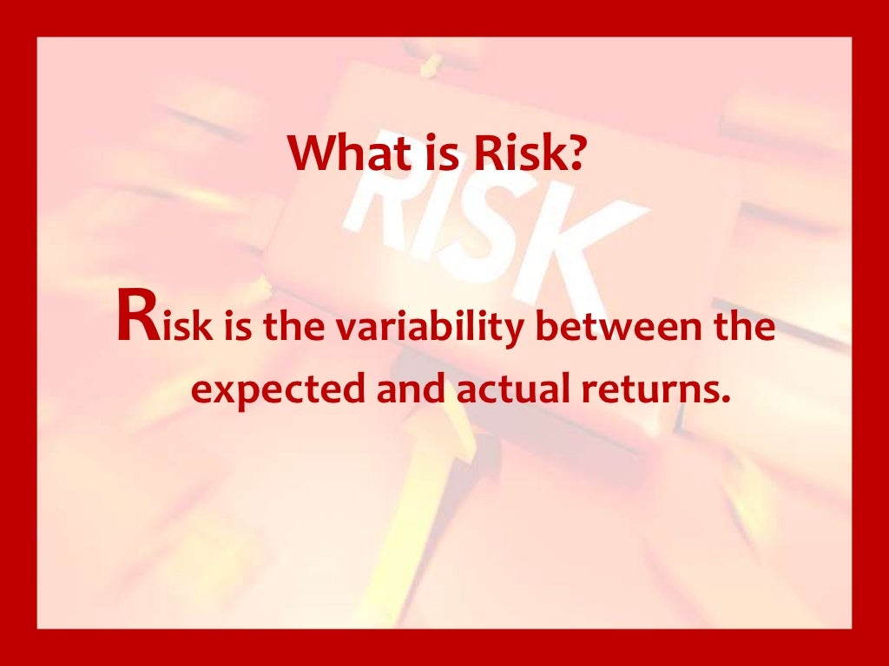

Slide 22


Slide 23
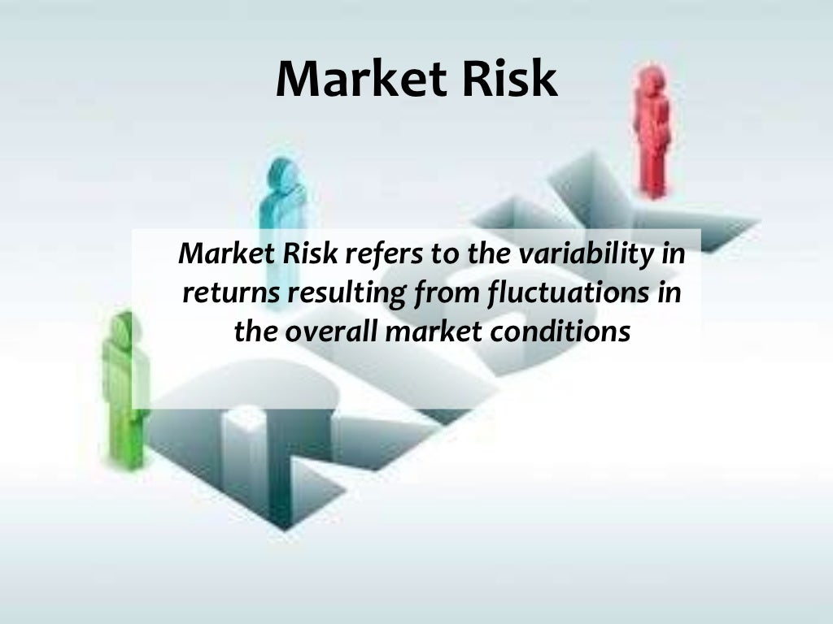

Slide 24
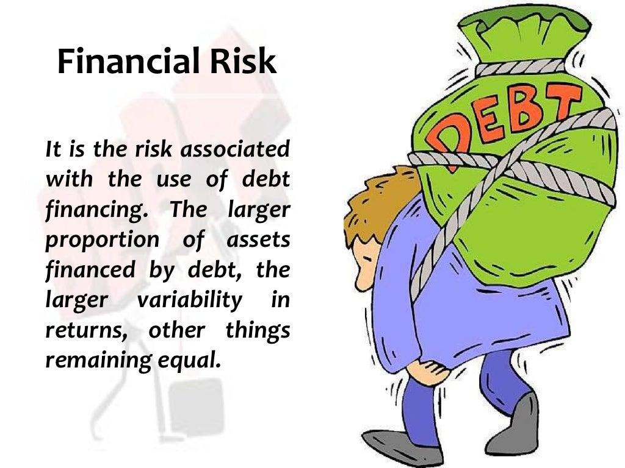

Slide 25


Slide 26
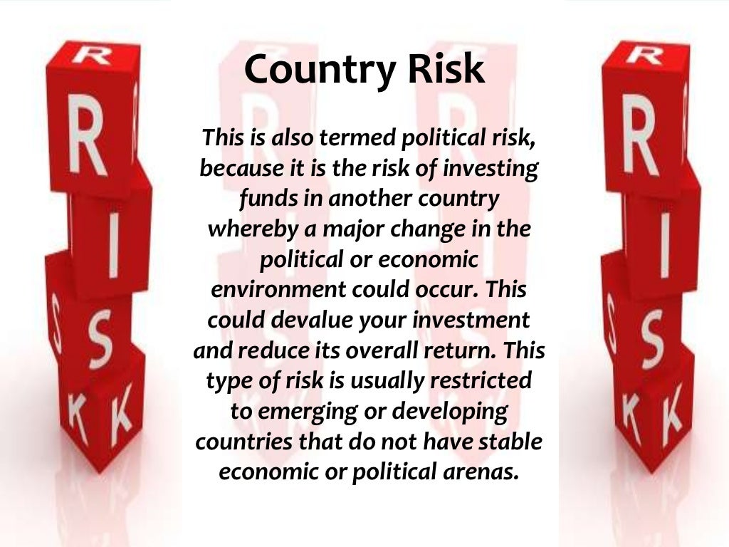

Slide 27
Stand-Alone Risk
The risk that an investor faces when he holds only one single asset as an investment.
Standalone risk arises when we go against the policy of diversification of portfolios

Slide 28
Methods of Calculating Stand-alone risk
Sensitivity analysis
Scenario analysis
Break-even analysis

Slide 29


Slide 30
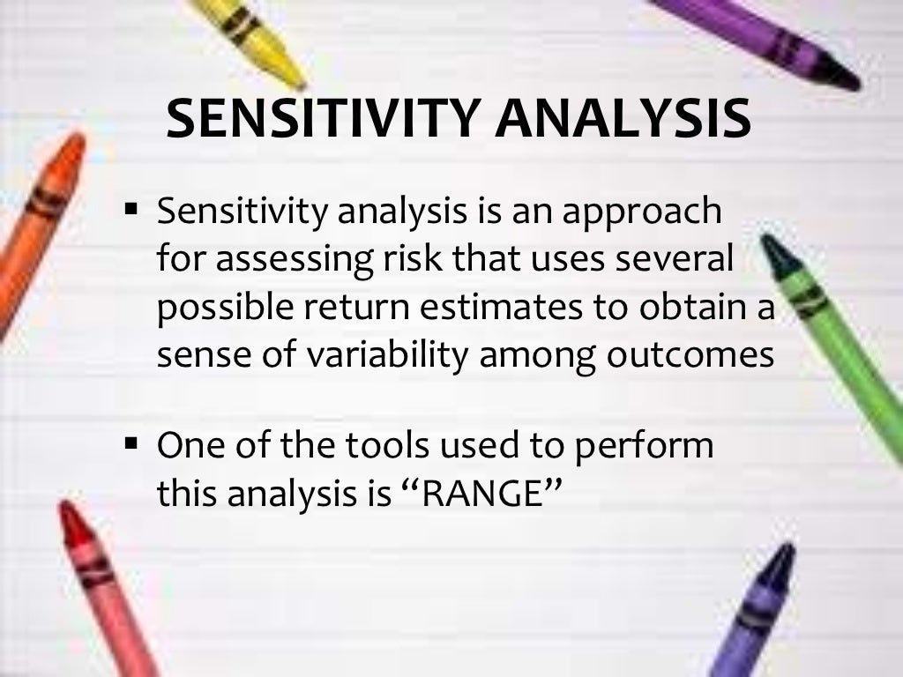

Slide 31
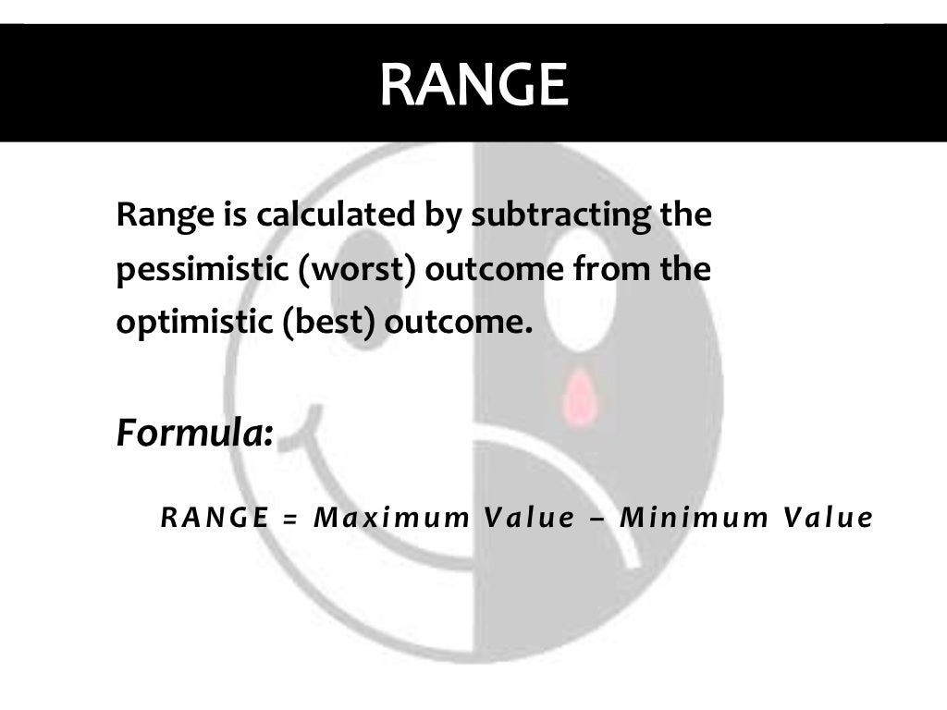

Slide 32
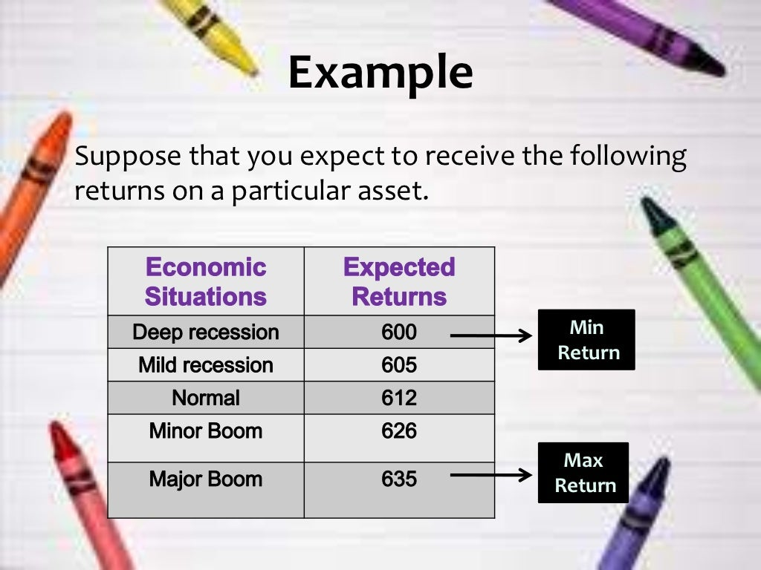

Slide 33
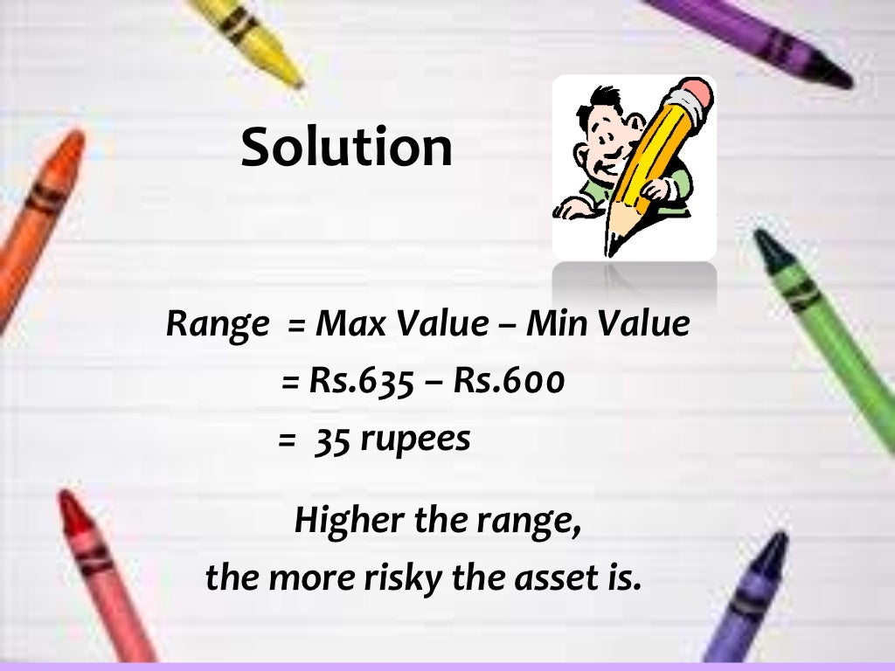

Slide 34
Scenario analysis
Scenario analysis is a method for predicting the possible occurrence of an object or the consequences of a situation, assuming that a phenomenon or a trend will be continued in the future.

Slide 35
Scenario analysis Example
An example of scenario analysis what would happen to my revenue if I charged more for each loaf of bread? In the simple case, where the volume of bread sold doesn't depend on the price of the bread, the analysis is very easy. An X% rise in the price per loaf will lead to an X% increase in sales.

Slide 36
Break-even analysis
A break-even analysis is a financial calculation that weighs the costs of a new business, service or product against the unit sell price to determine the point at which you will break even.
It reveals the point at which you will have sold enough units to cover all of your costs.

Slide 37
Break-even analysis Example
Happy Ltd has fixed costs of Rs. 10,000 vs. Sad Ltd has fixed costs of Rs. 1, 00,000 selling similar products, Happy Ltd will be able to break-even with the sale of lesser products as compared to Sad Ltd.

Slide 38
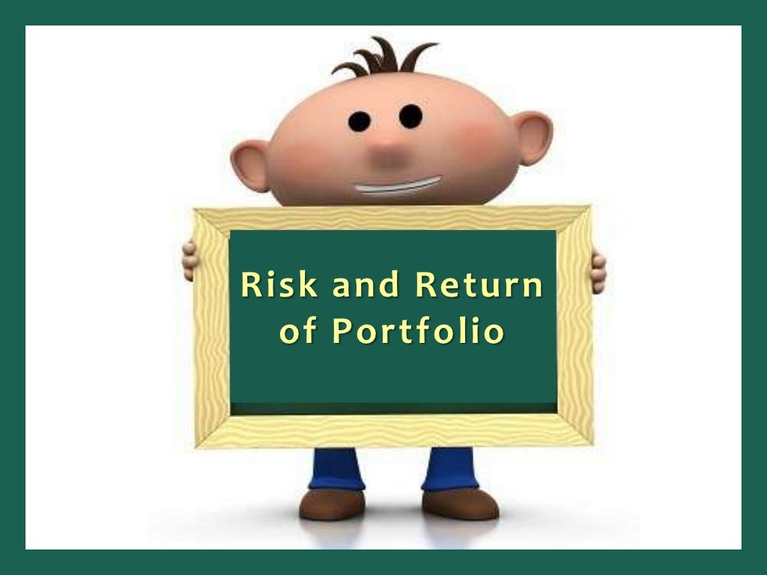

Slide 39
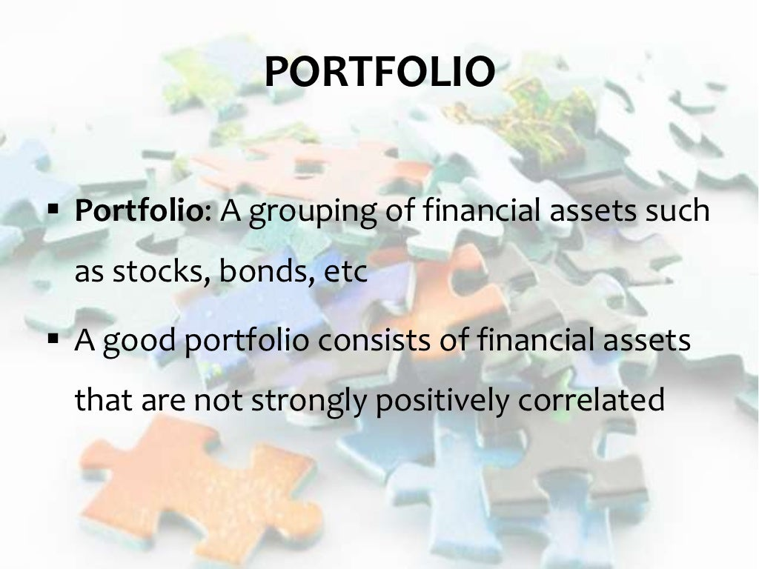

Slide 40
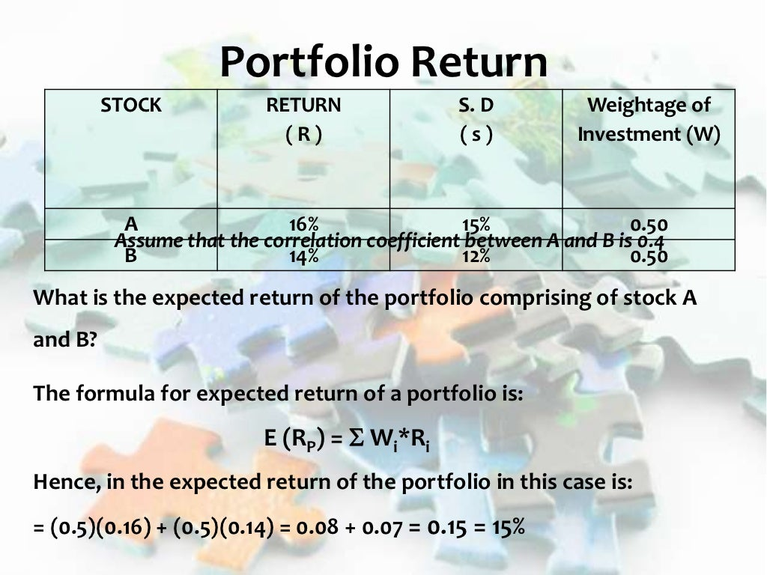

Slide 41
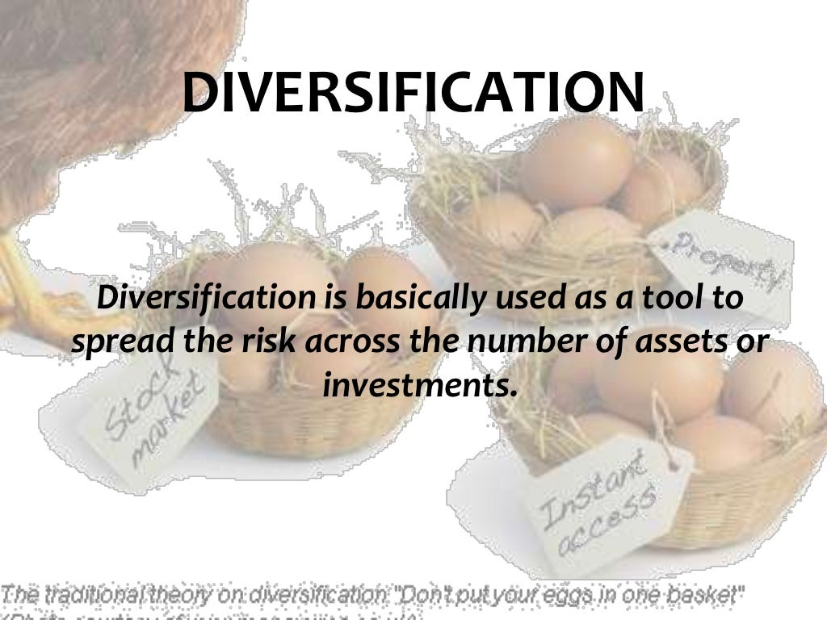

Slide 42
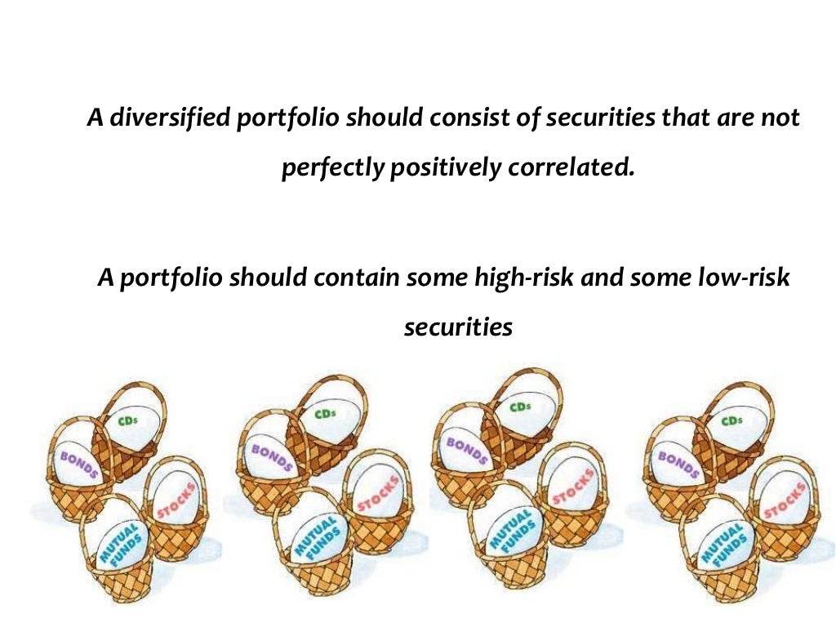

Slide 43
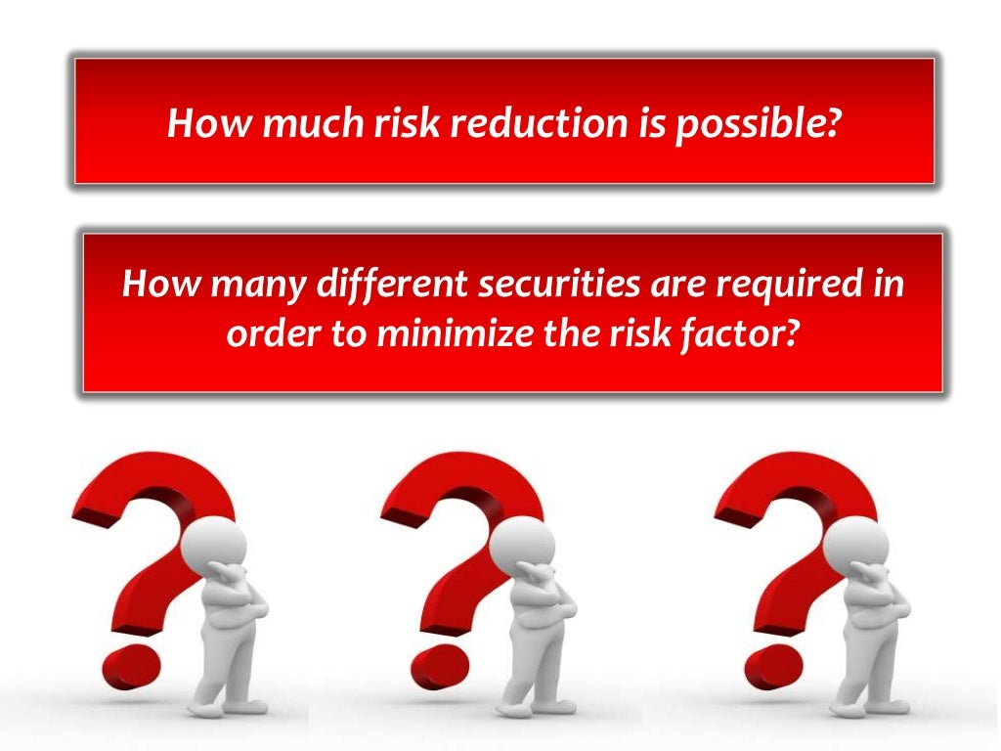

Slide 44
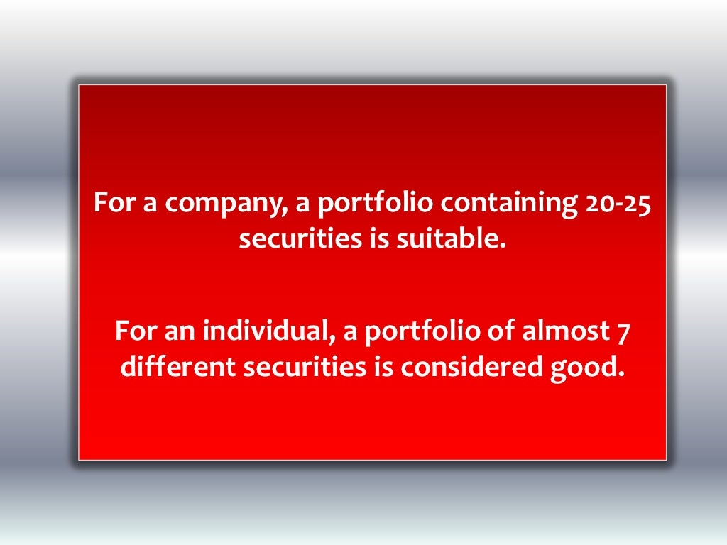

Slide 45
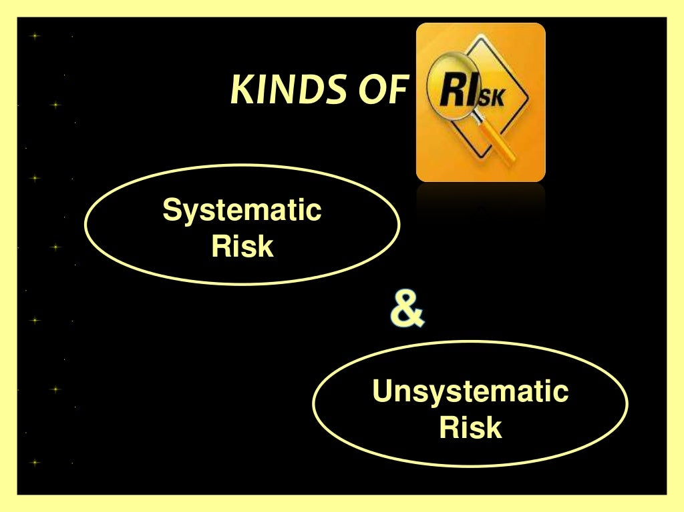

Slide 46
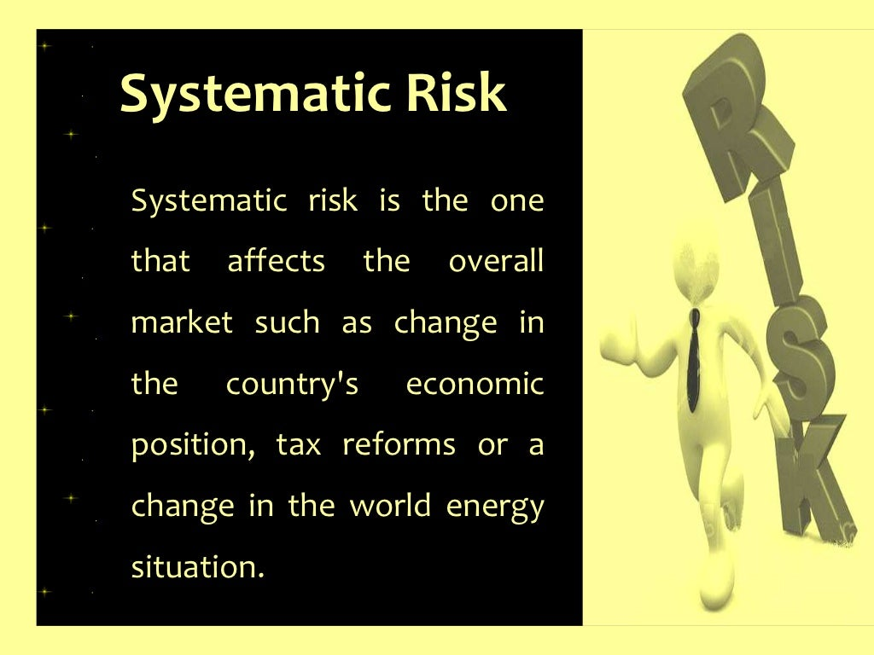

Slide 47
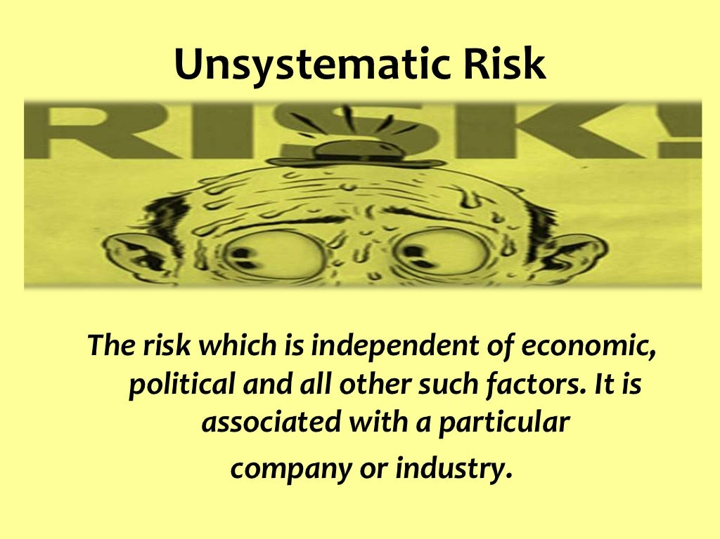

Slide 48


Slide 49
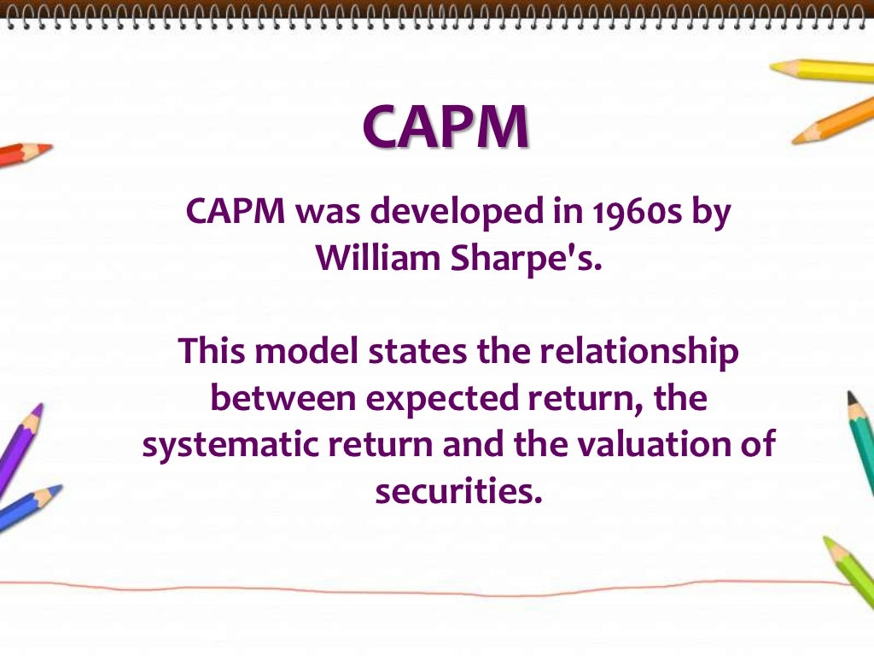

Slide 50
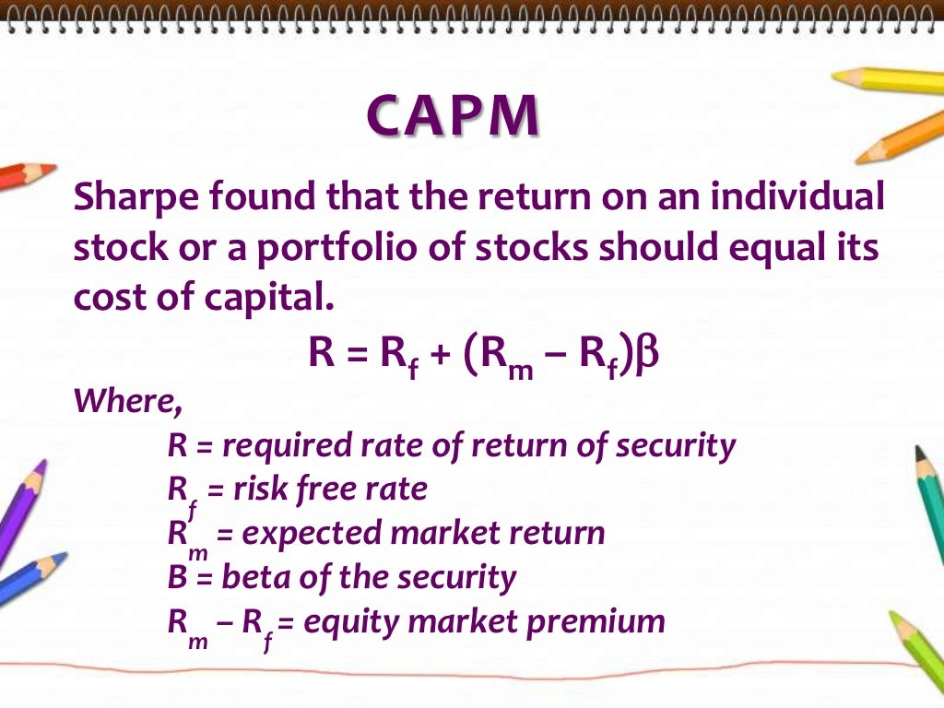

Slide 51
